Slide 1



Streamlit

Slide 2
The fastest way to build and share data apps
Streamlit is an open-source Python library that makes it easy to create and share beautiful, custom web apps for machine learning and data science. In just a few minutes you can build and deploy powerful data apps

Slide 3
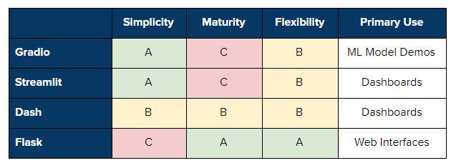
Comparing several web UI tools for data science!
https://towardsdatascience.com/gradio-vs-streamlit-vs-dash-vs-flask-d3defb1209a2

Slide 4
Install Streamlit
pip install streamlit
Streamlit requires python version 3.6+

Slide 5
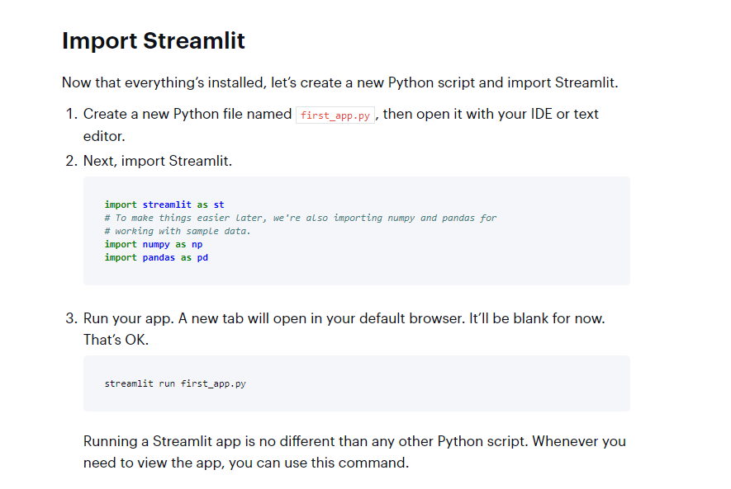

Slide 6
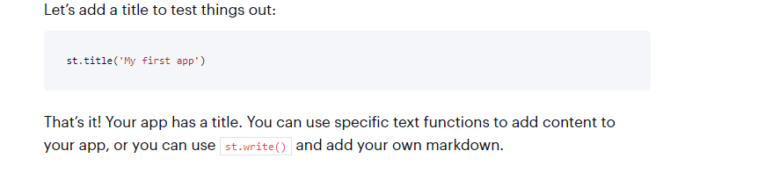
Add a title

Slide 7
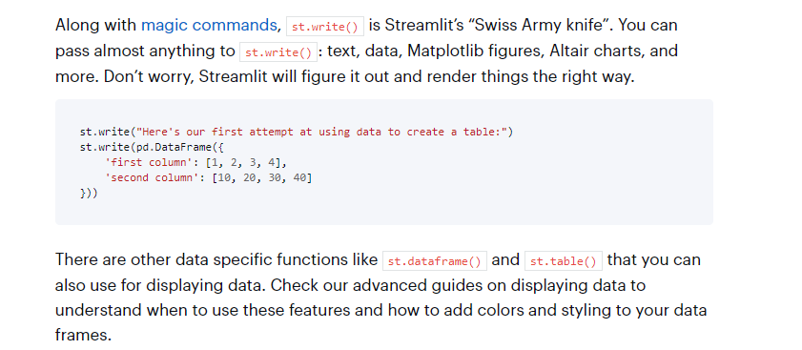
Write a data frame

Slide 8
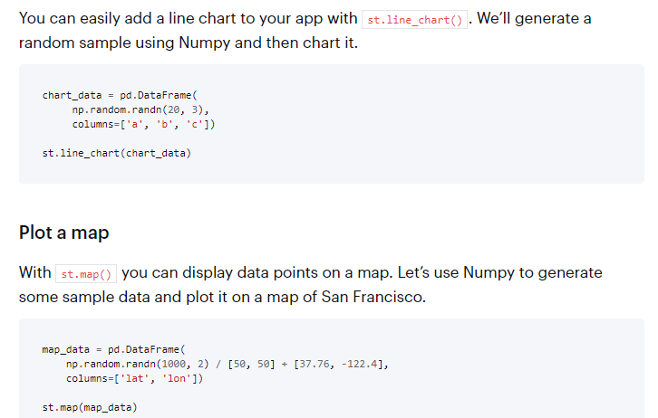
Draw charts and maps

Slide 9
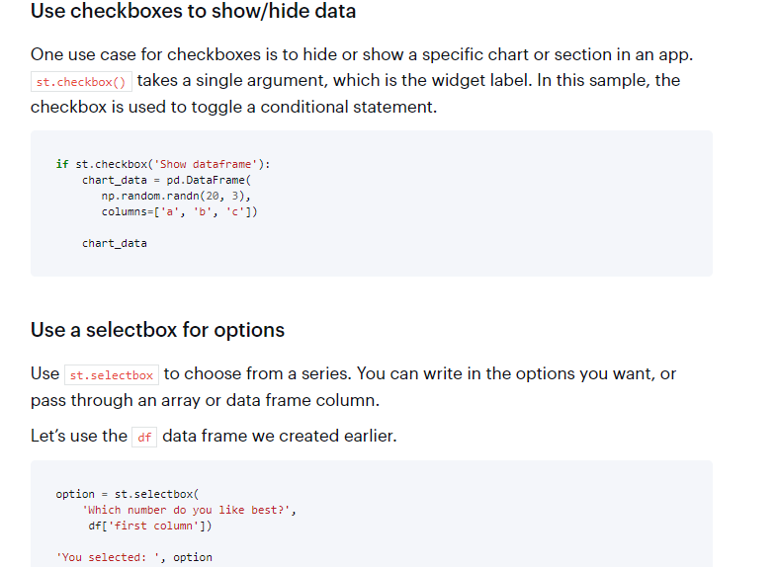
Add interactivity with widgets

Slide 10
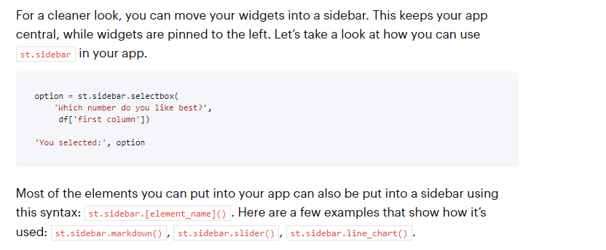
Lay out your app (Sidebar)

Slide 11
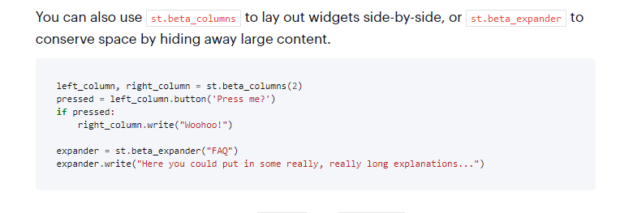
Lay out your app (widgets side-by-side)

Slide 12
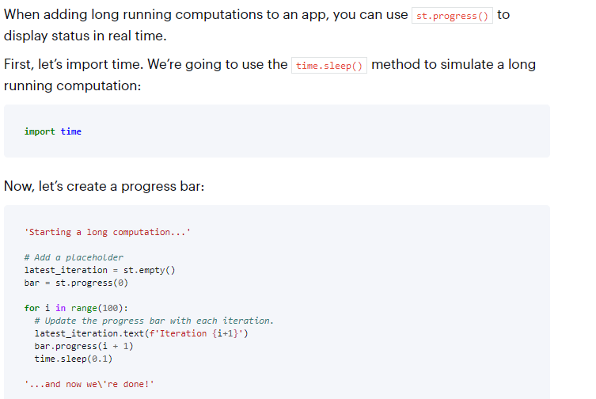
Show progress

Slide 13
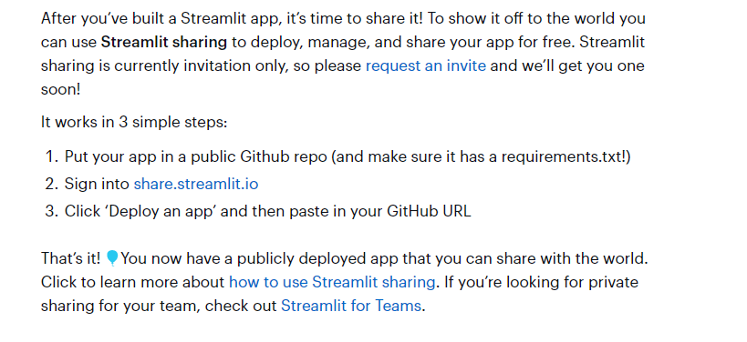
Share your app

Slide 14
Practical
Amazure Online Shop Dashbaord

Slide 15
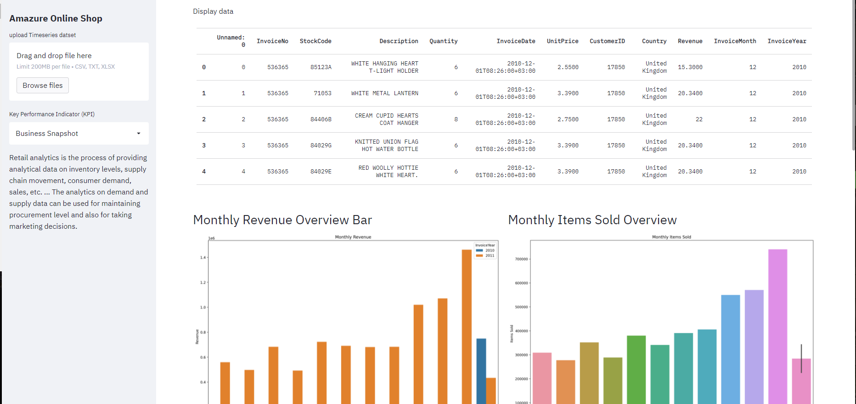
Amazure Online Shop Dashbaord

